Slide 1
CS 205
Artificial Intelligence

Slide 2
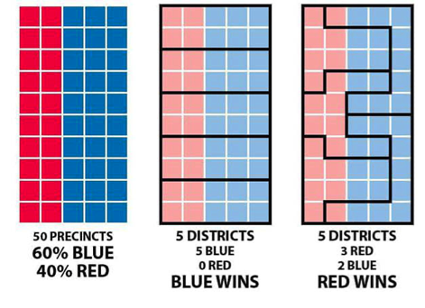
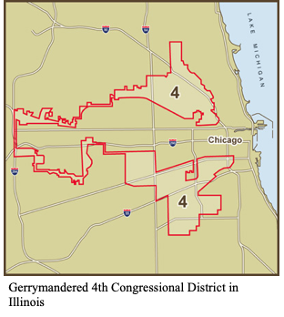
Fun: rigging an election
Who should win, blue or red?
The most districts won, wins.

Slide 3
Random Shorts (quick topic summaries)
genetic algorithms
simulated annealing
situation calculus
constraint satisfaction
planning
more heuristic and utility functions

Slide 4
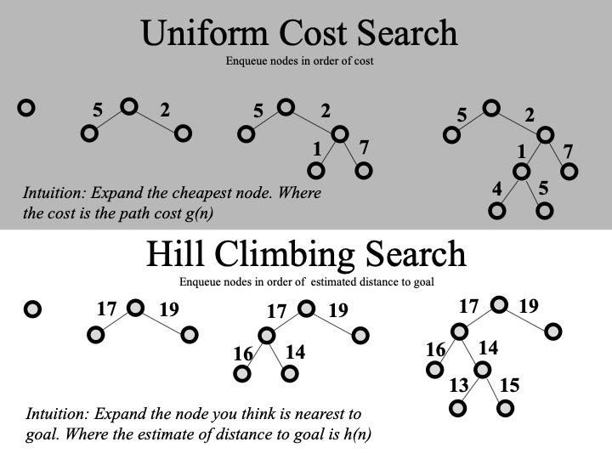
Hill Climbing
What's the next node?

Slide 5
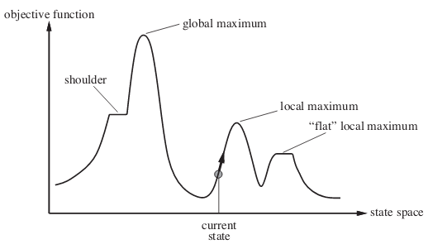
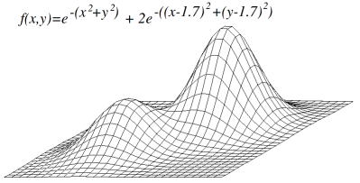
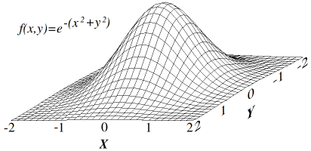
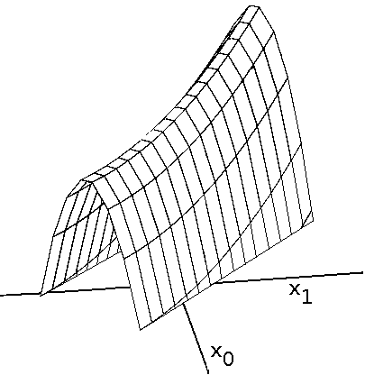
Hill Climbing Local Search
IMG source: GeeksForGeeks and Wikipedia
function HILL-CLIMBING(problem) returns a solution state
inputs: problem, a problem
static: current, a node; next, a node
current <— MAKE-NODE(INITIAL-STATE[problem])
loop do
next— a highest-valued successor of current
if VALUE[next] < VALUE[current] then return current
current *—next
end

Slide 6
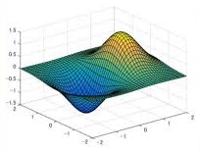
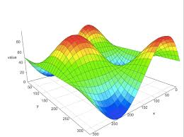
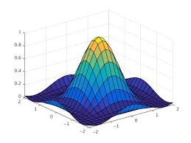
Random Restart Hill Climbing
Why settle for one attempt! Let's shotgun this thing.
Once, 50% chance of not finding the global maximum.
Twice, 25% chance of not finding the global maximum.
Thrice, __% chance of not finding the global maximum.
So what are my chances of actually finding the global maximum, with N random restarts?
~50%

Slide 7
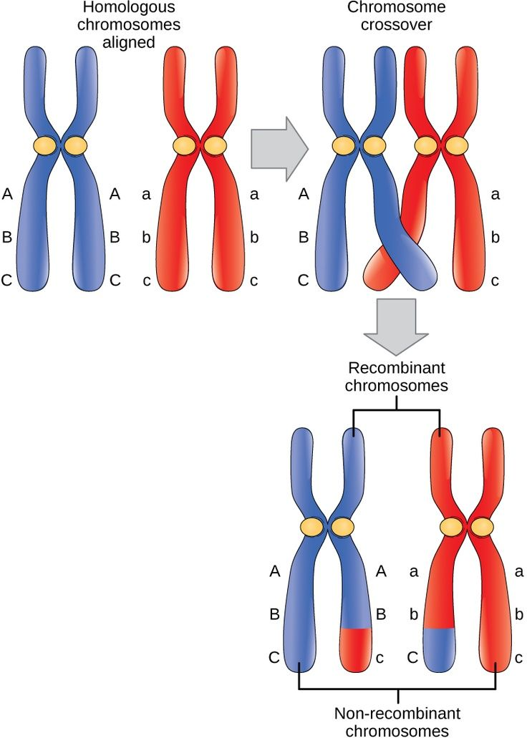
Genetic (evolutionary) Algorithms
Ingredients:
initial population (solutions, i.e., chromosomes)
parents & offspring
fitness function (via objective function)
point & cross-over mutations
convergence
speciation heuristic
START
Generate the initial population
Compute fitness
REPEAT
Selection
Crossover
Mutation
Compute fitness
UNTIL population has converged
STOP

Slide 8
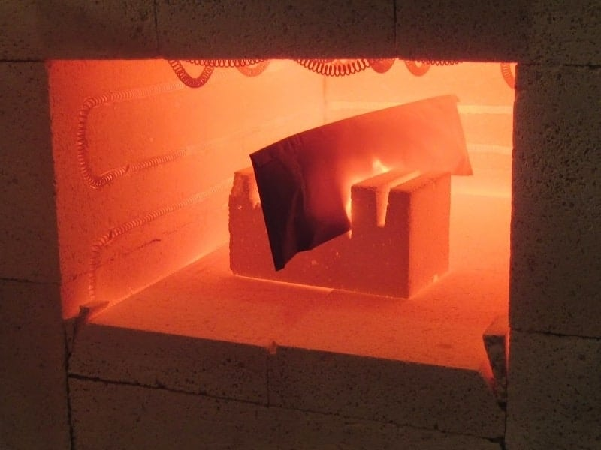
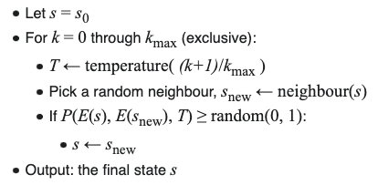
Simulated Annealing
Ingredients:
initial state
temperature, T
internal energy, E(s)
candidate function (neighbor)
transition probability function, P(e_{i},e_{j},T)
final state (minimal internal energy)
Annealing is a heat treating process that softens steel. This can make it easier to form or machine.
Source: https://makeitfrommetal.com/beginners-guide-on-how-to-anneal-steel/

Slide 9
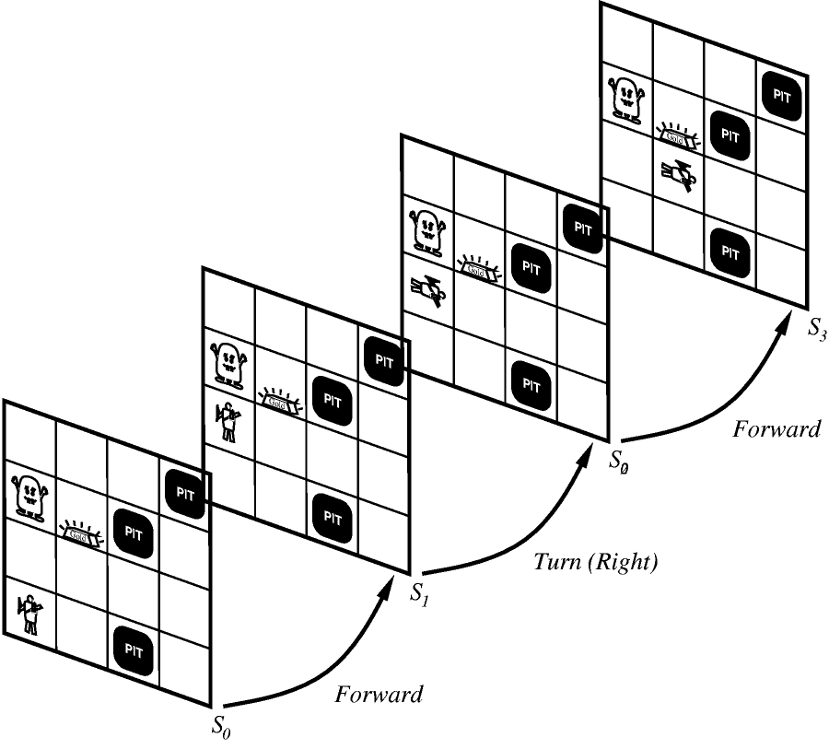

Situation Calculus
Ingredients:
initial state
states
actions (sequences of actions)
fluents (relations over states)
goals
Situation Calculus is a predicate-calculus formalization of states, actions, and the effects of actions on states.
–McCarthy & Hayes 1969
S0: On(B,A) ∧ On(A,C) ∧ On(C,F1) ∧ Clear(B) ....
do(move(B,F1,S0), S1)

Slide 10
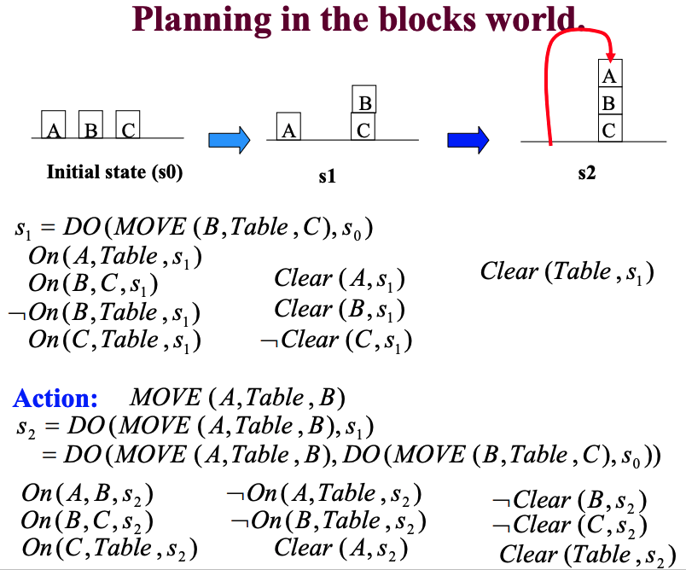
Planning
Task: generate correct sequence of actions to reach goal.
As you can imagine, very important in robotics.

Slide 11
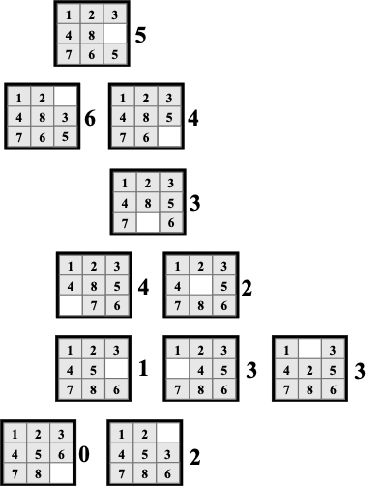
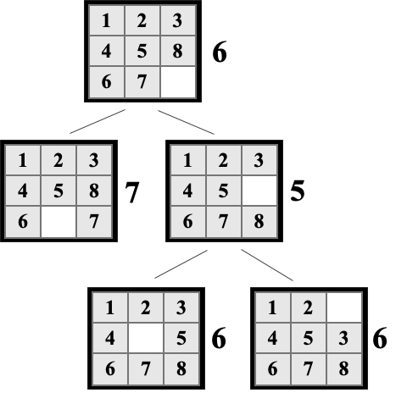
Heuristic and Utility Functions
e.g., 8-puzzle:
no. misplaced tiles
sum misplaced tile manhattan distance
manhattan distance
diagonal distance (Chebyshev vs octile)
euclidean distance
e.g., Tic-Tac-Toe
no. 3-len max minus no. 3-len min
e.g., Chess
pawn=1, knight=3, bishop=3, rook=5, queen=9
sum(w - b) / sum(w + b)
weighted sum based on attack value
ask an expert
become an expert
machine learning

Slide 12
More resources...
Let's take a look at Prof Eamonn's slides for a minute.

